Slide 1
Explore Linear Relationship:
Tracker Fund (HK.2800)
vs.
HIBOR and Hang Seng Index
Agnes

Slide 2

Hong Kong Inter-bank Offered Rate (HIBOR)
The rate of interest offered on Hong Kong dollar loans by banks in the interbank market
based on quotations from 20 banks designated by the Hong Kong Association of Banks
released on the website of the HKAB each business day (excluding Saturdays) at 11:15 a.m.

Slide 3

Tracker Fund of Hong Kong (2800.HK)
most liquid ETFs (exchange-traded fund) in the Hong Kong market
closely correspond to the performance of the Hang Seng Index
aims to pay dividend on semi-annual basis
high dividend stock

Slide 4
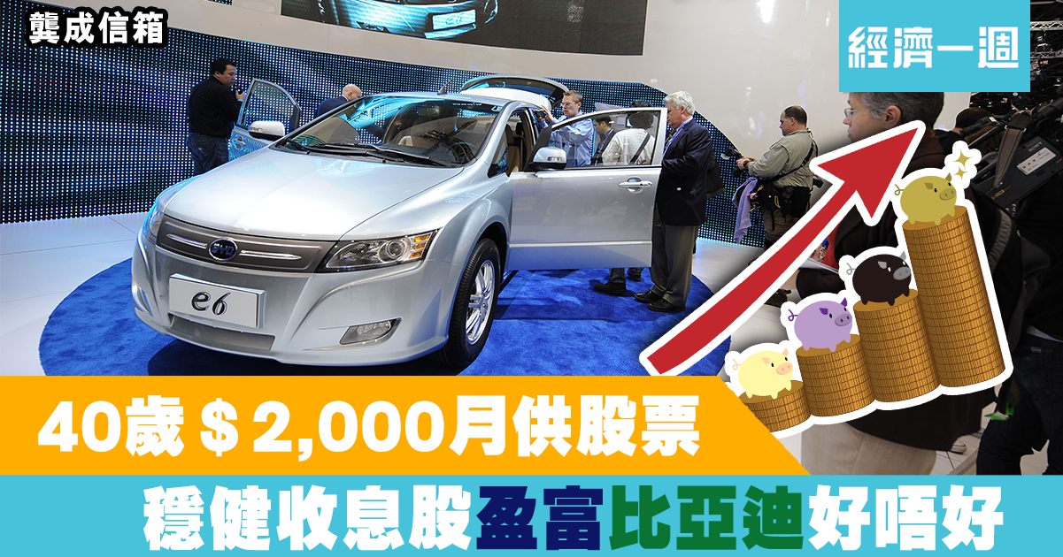
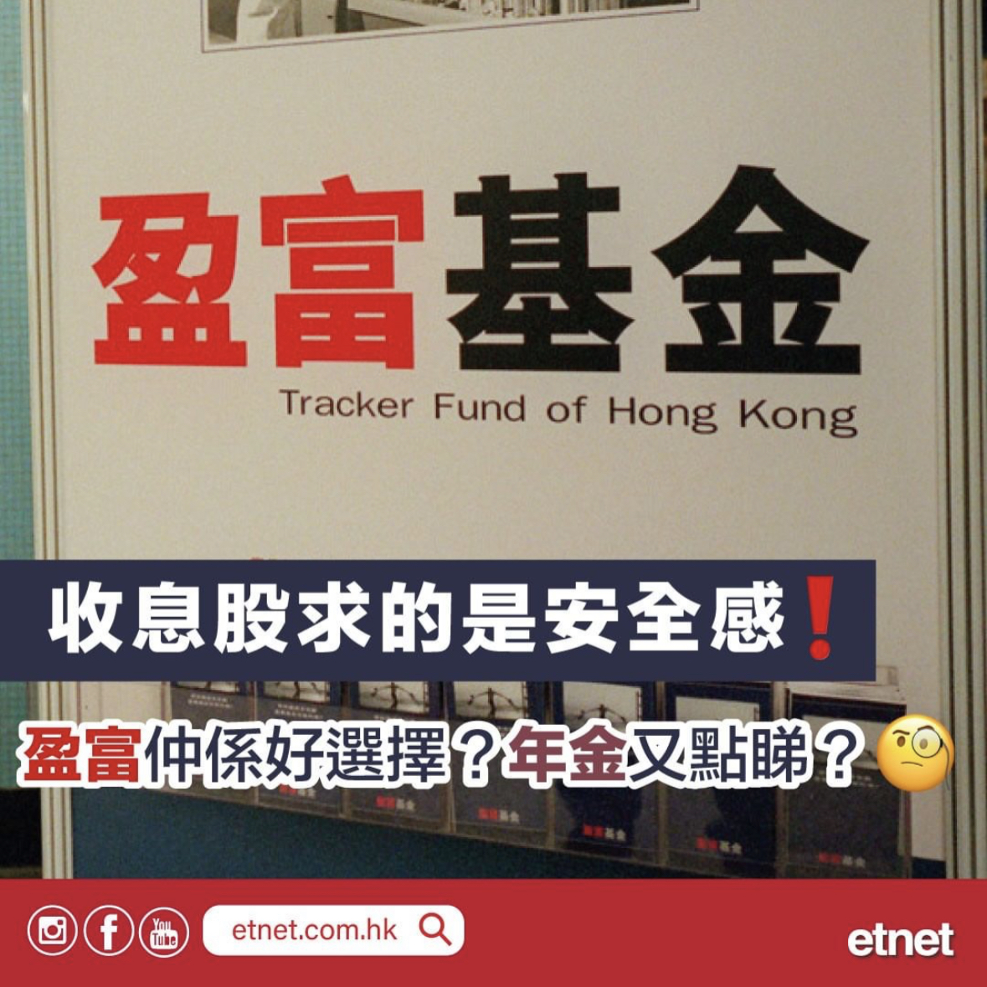

Why??

Slide 5
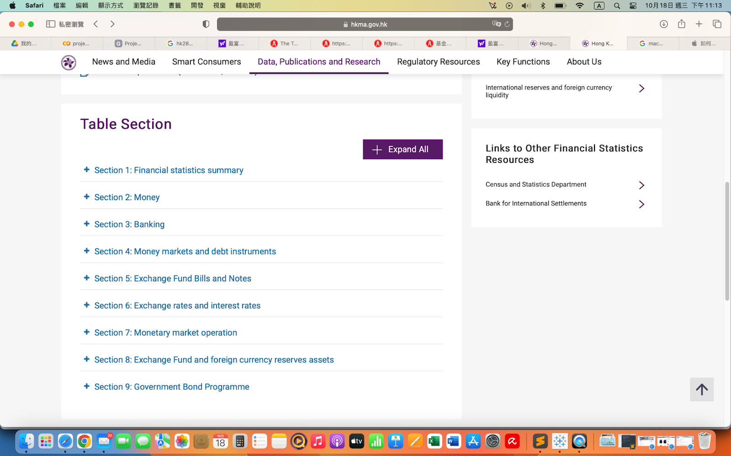
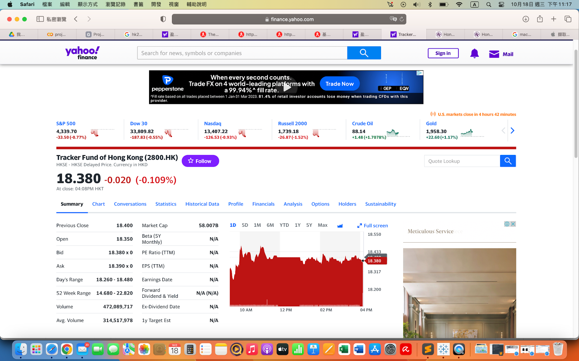
Data Source
1.Hong Kong Monetary Authority (https://www.hkma.gov.hk/eng) | 2. Yahoo Finance (https://finance.yahoo.com/)

Slide 6
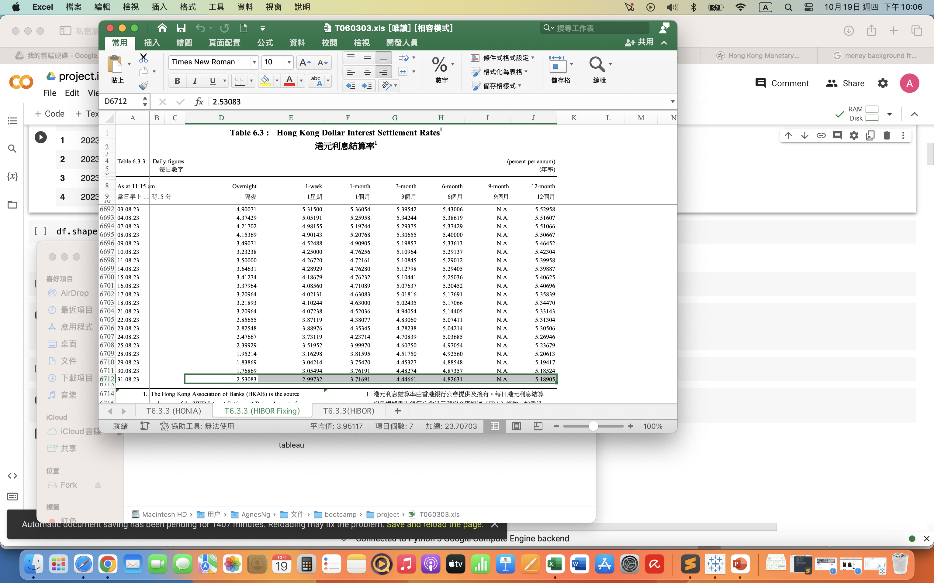
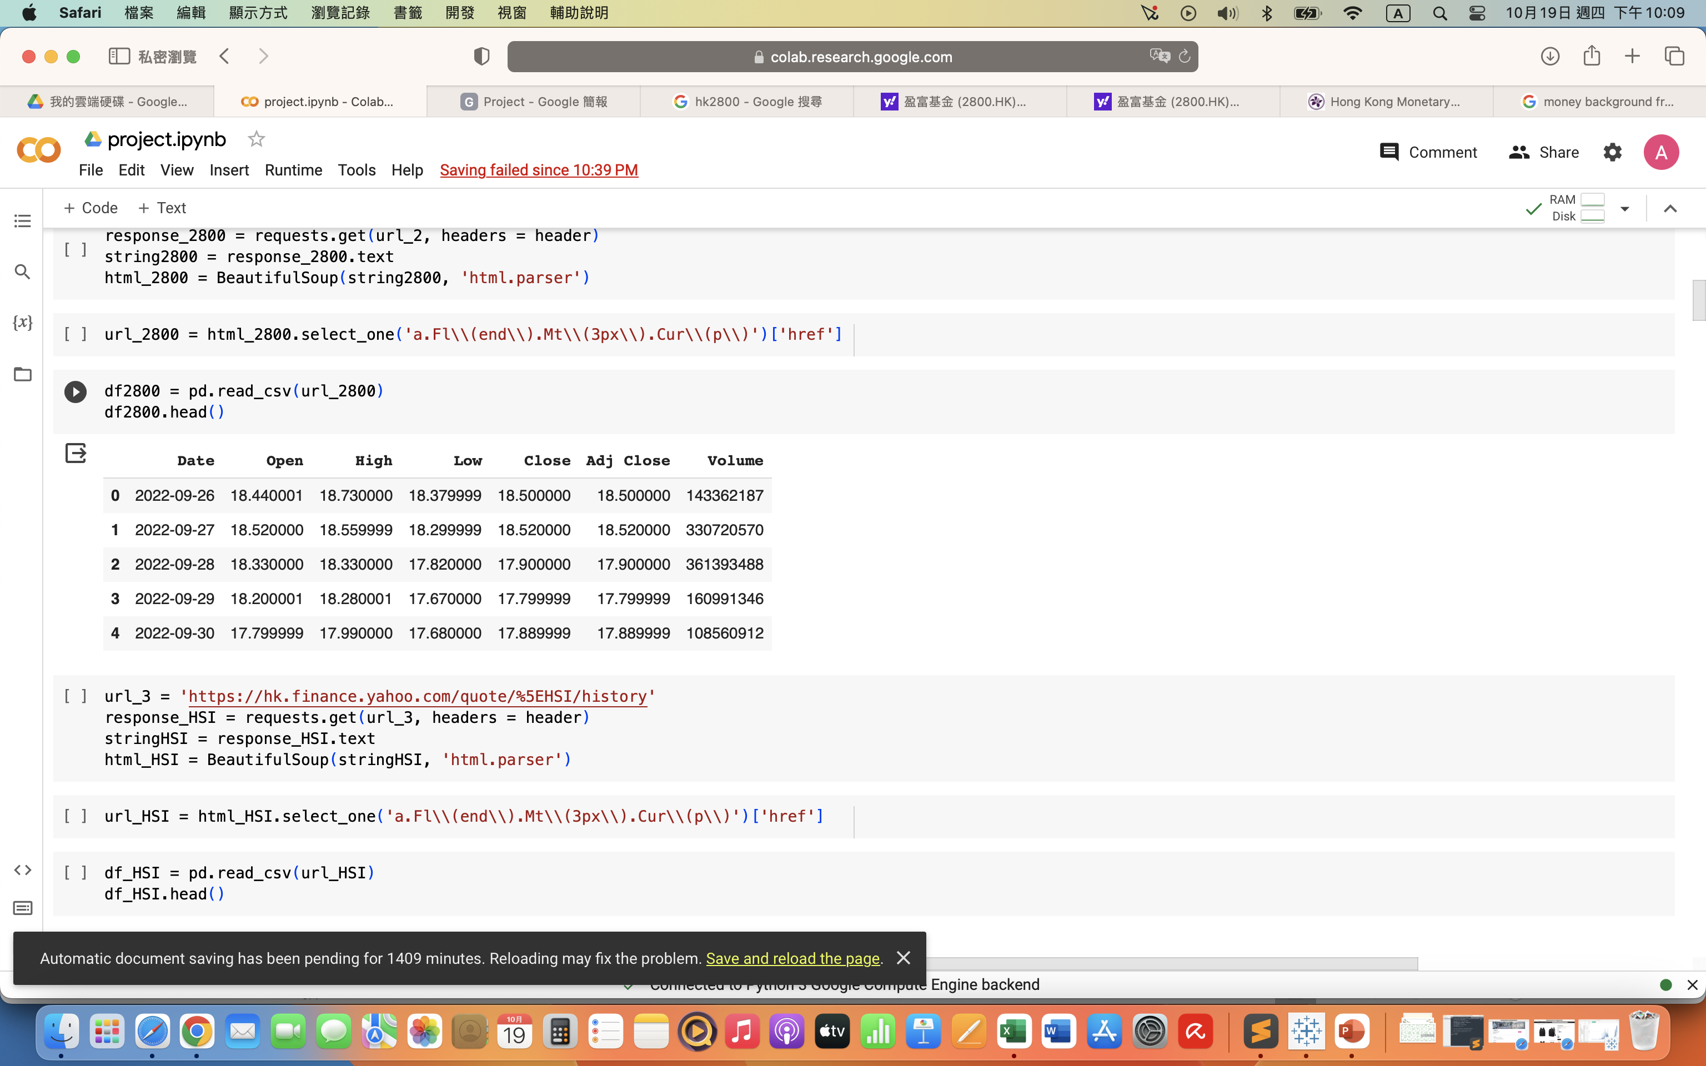
Tables
Databricks
Pandas
Web scraping
Spark

Slide 7
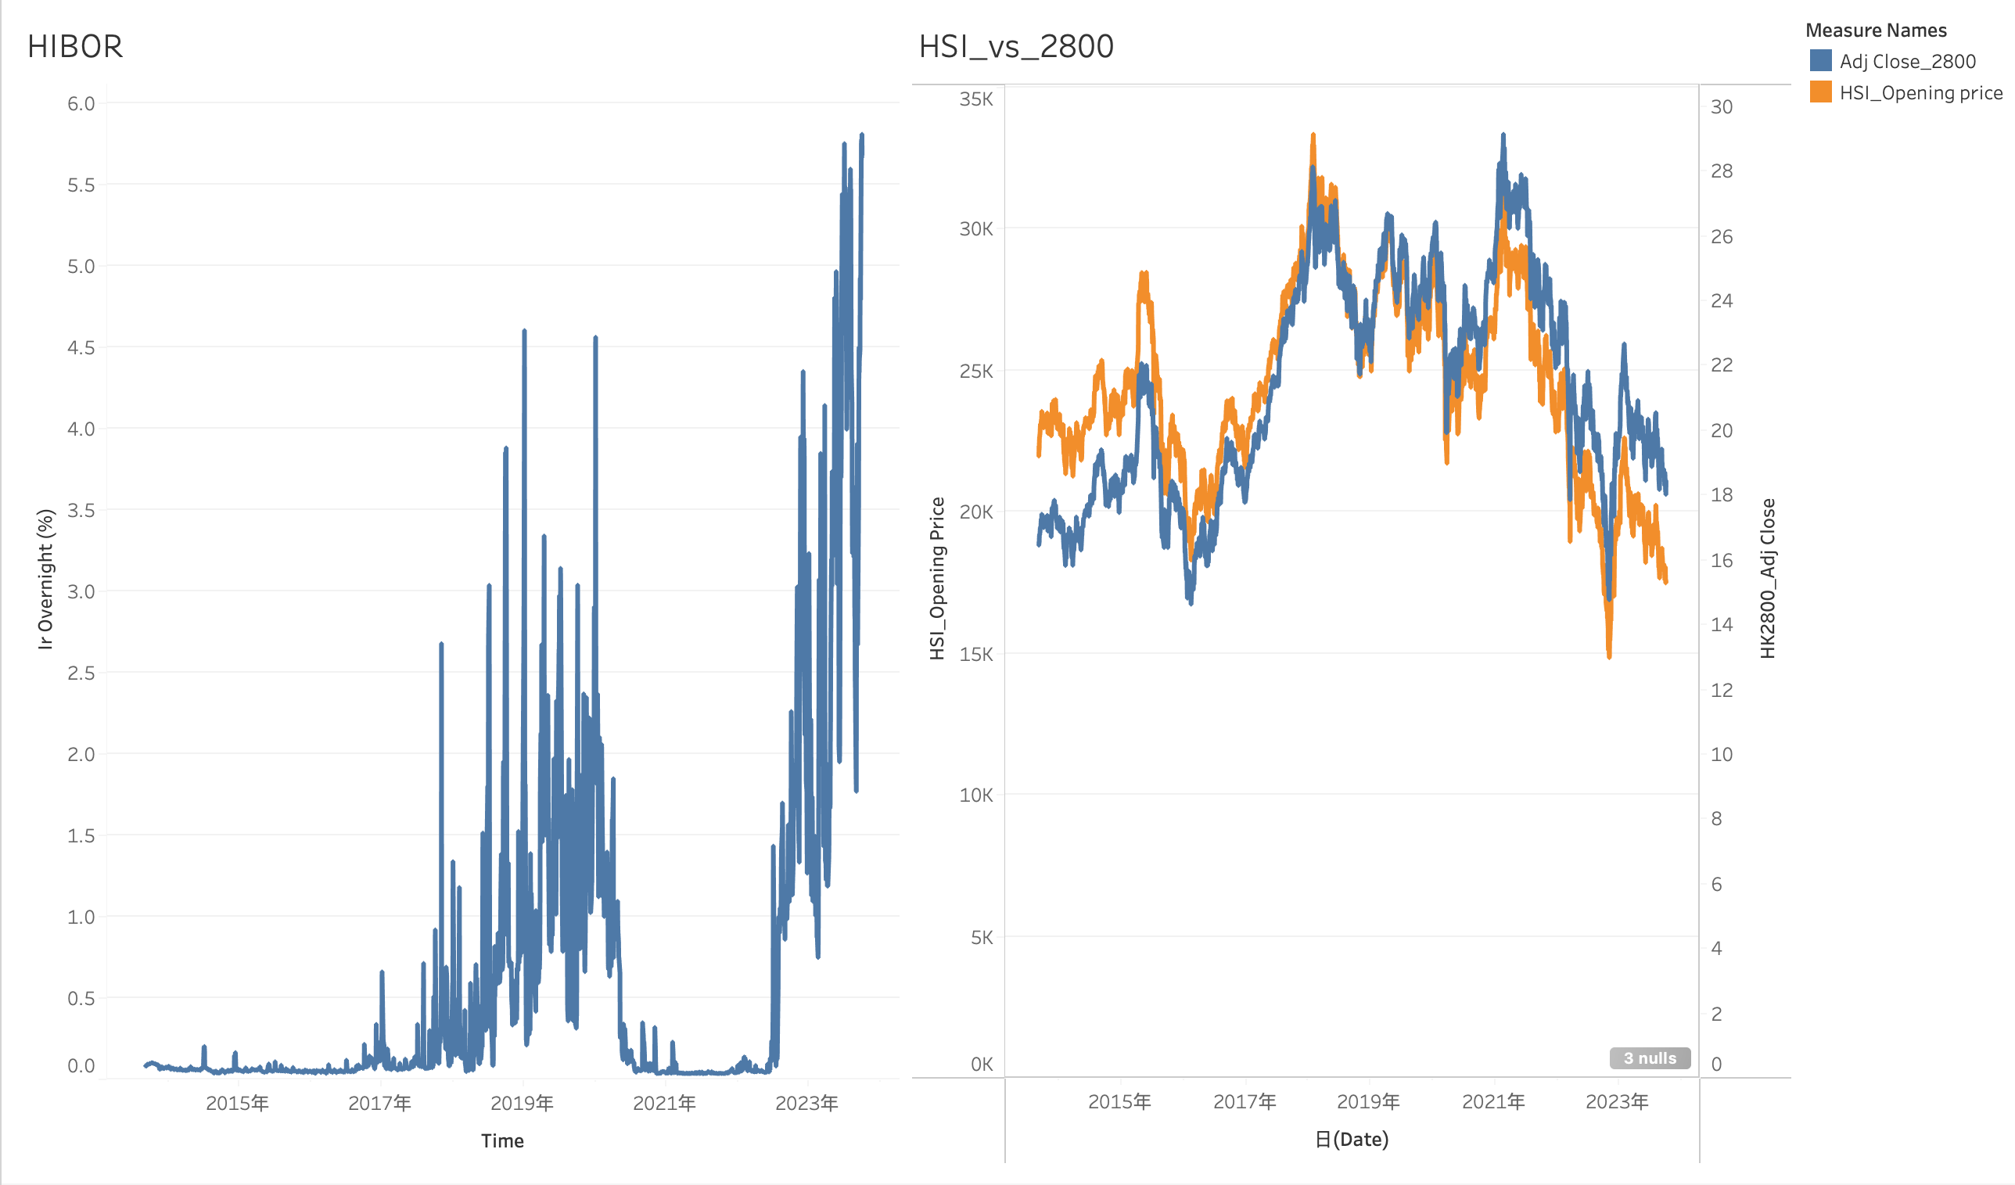
Feature Engineering

Slide 8
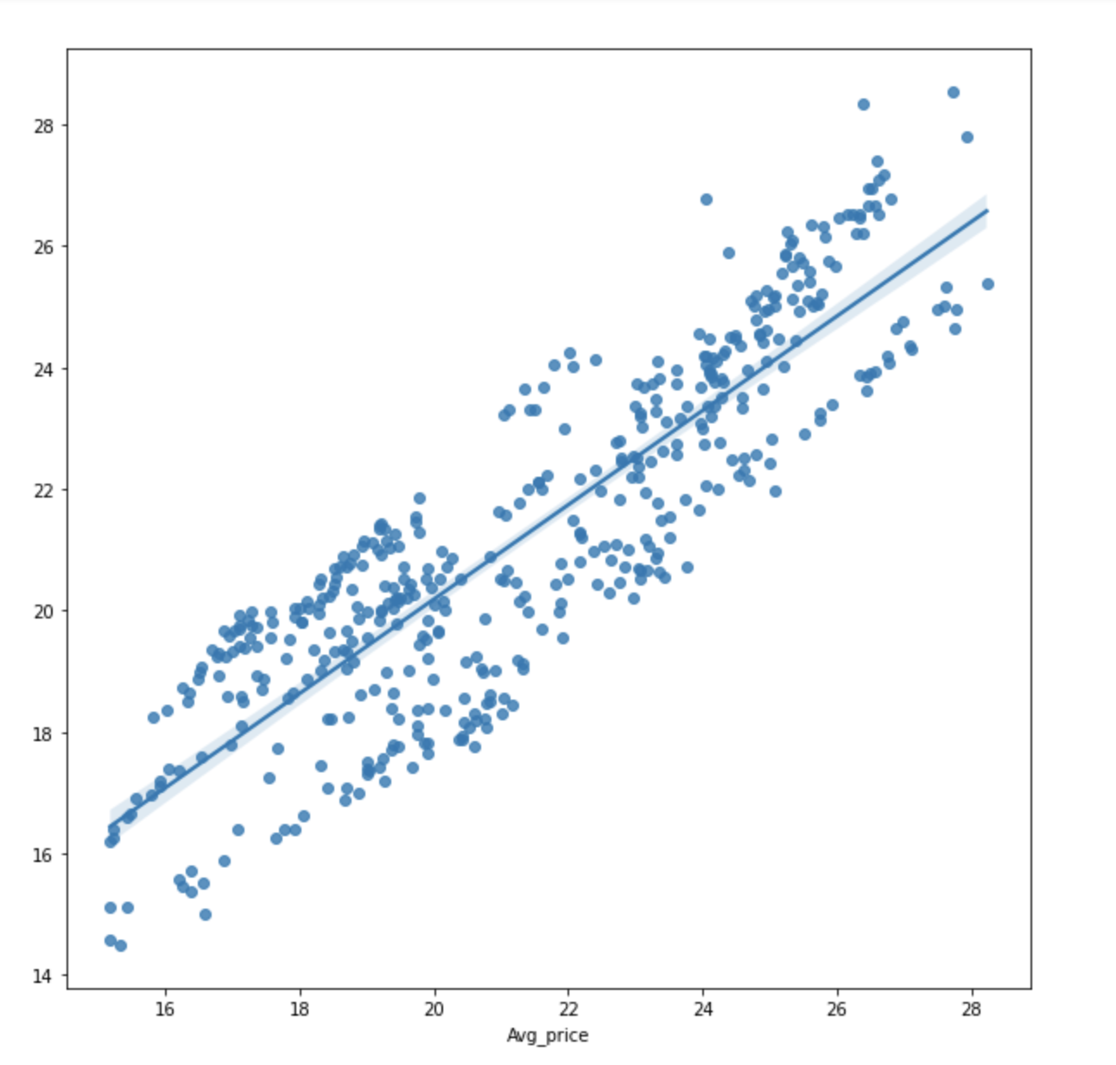
Linear Regression
R² score
0.7668599

Slide 9


